Slide 1
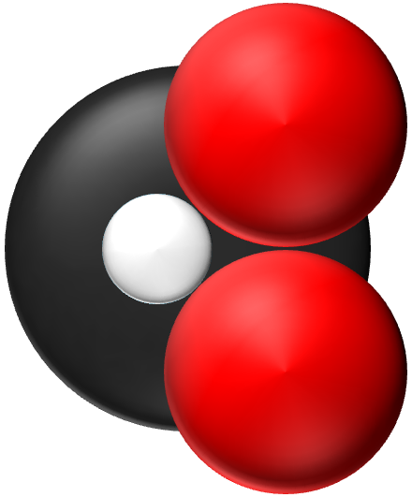
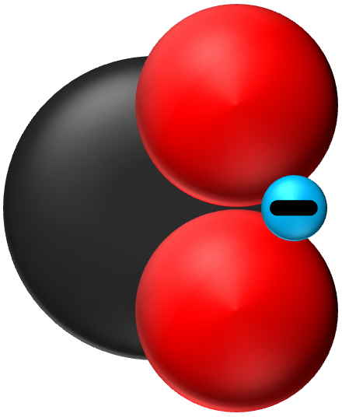
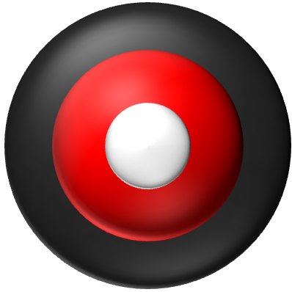
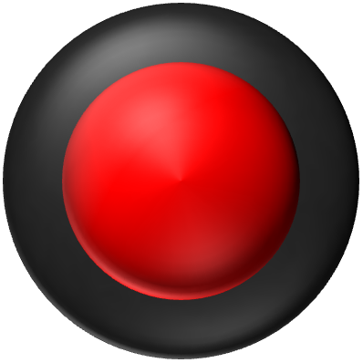
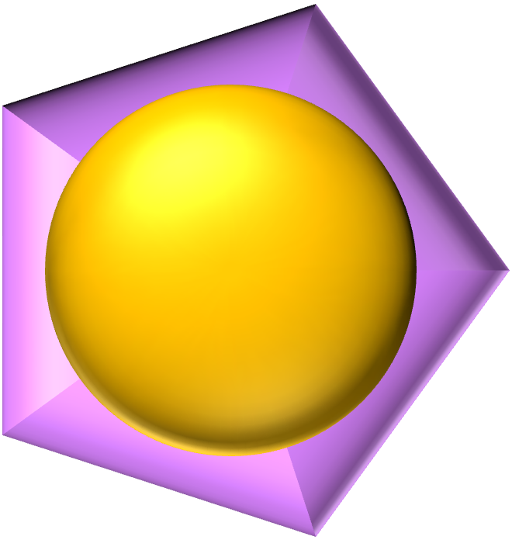
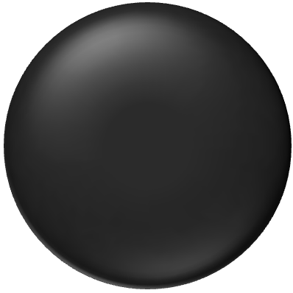

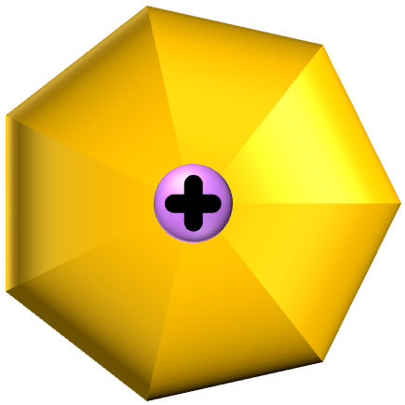
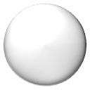
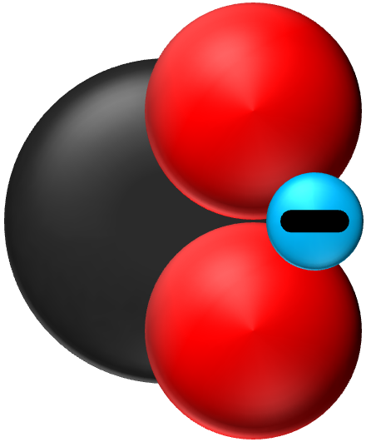
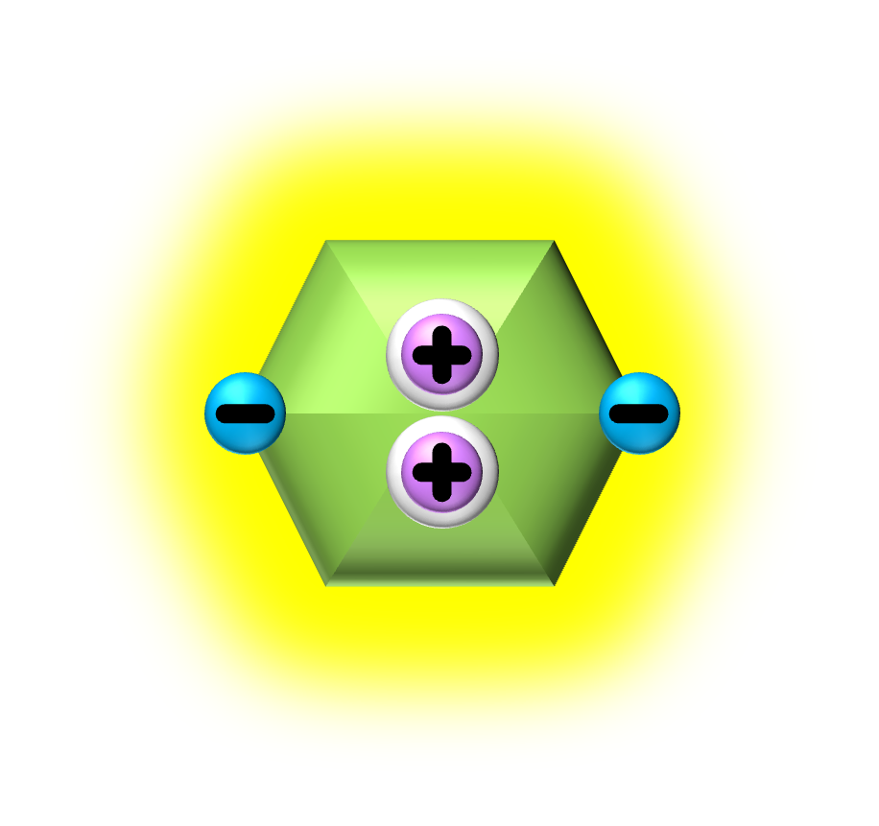


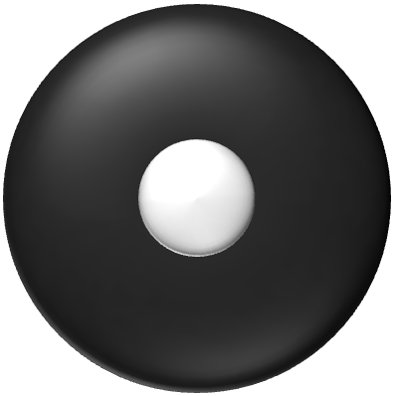
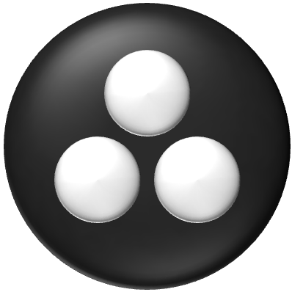
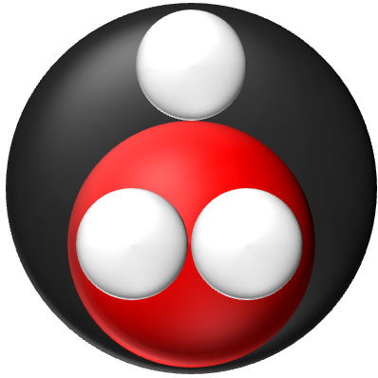
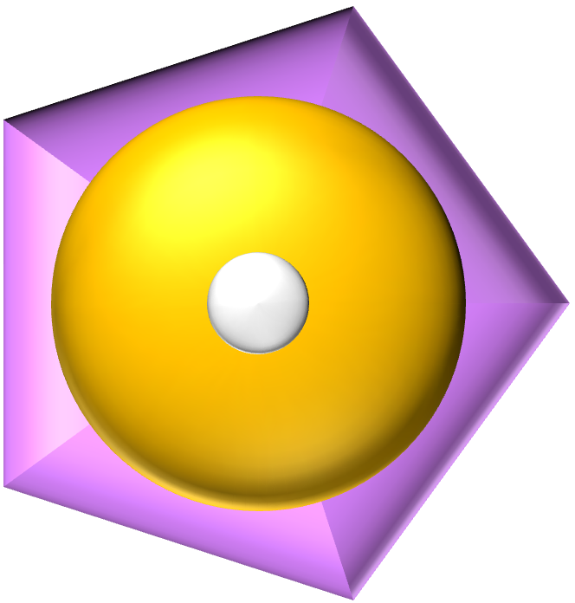
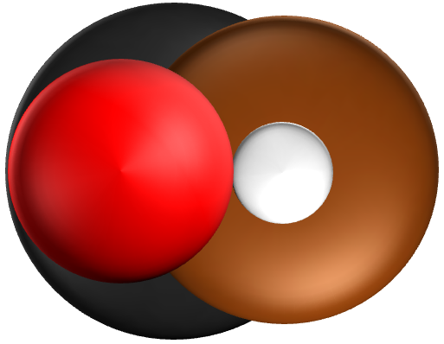
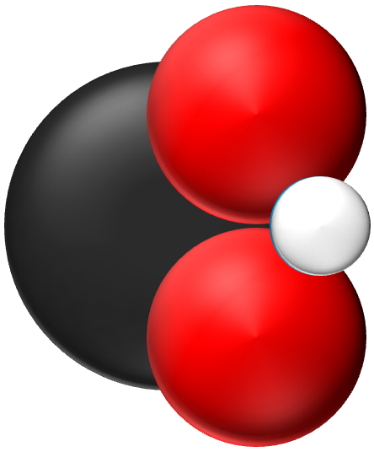
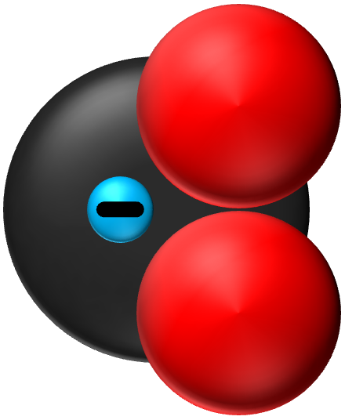
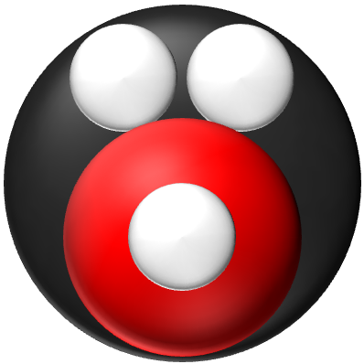
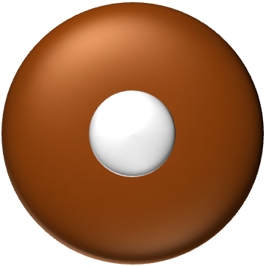
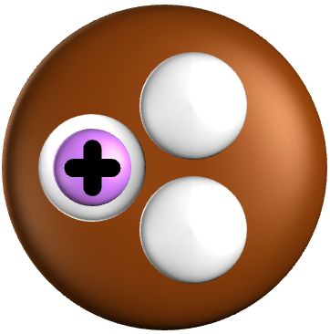

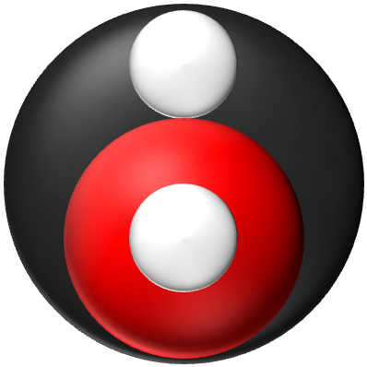
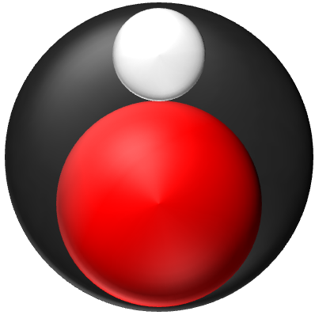

Slide 2
Acetyl-CoA:
CoA-S-(C=O)-CH3
Sucinate:
COO—CH2-(C=O)-COO⁻
Citrate:
COO—-CH2-((C-OH)-COO—)-CH2-COO—
Fumerate:
COO—CH2-(C=O)-COO⁻
Malate:
COO—CH2-(C=O)-COO⁻
Iso-Citrate:
COO—-CH2-((C-OH)-COO—)-CH2-COO—
Oxaloacelate:
COO—CH2-(C=O)-COO⁻

Slide 3
Citrate
Alpha-Ketoglutarate
COO—-CH2-((C-OH)-COO—)-CH2-COO—
COO—-(C=O)-CH2-CH2-COO—
Iso-Citrate
COO—-(CH-OH)-(CH-COO—)-CH2-COO—
Succinyl-CoA
(COA-SH)-(C=O)-CH2-CH2-COO—

Slide 4
Succinyl-CoA
Succinate
COO—-CH2-CH2-COO—
Fumerate
COO—-CH-CH-COO—
(COA-S)-(C=O)-CH2-CH2-COO—
Malate
Succinate
COO—-CH2-(CH-OH)-COO—
Oxaloacetate
COO—-CH2-(C=O)-COO—
COO—-CH2-CH2-COO—

Slide 5
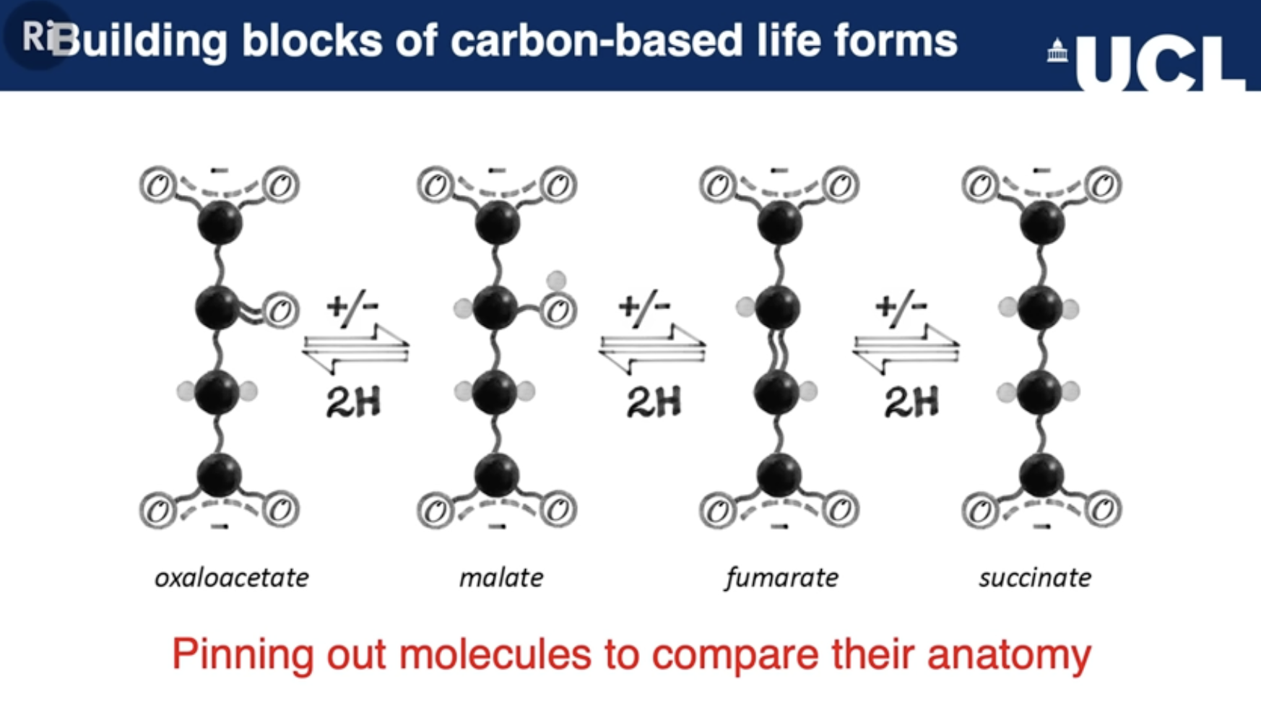

Slide 7
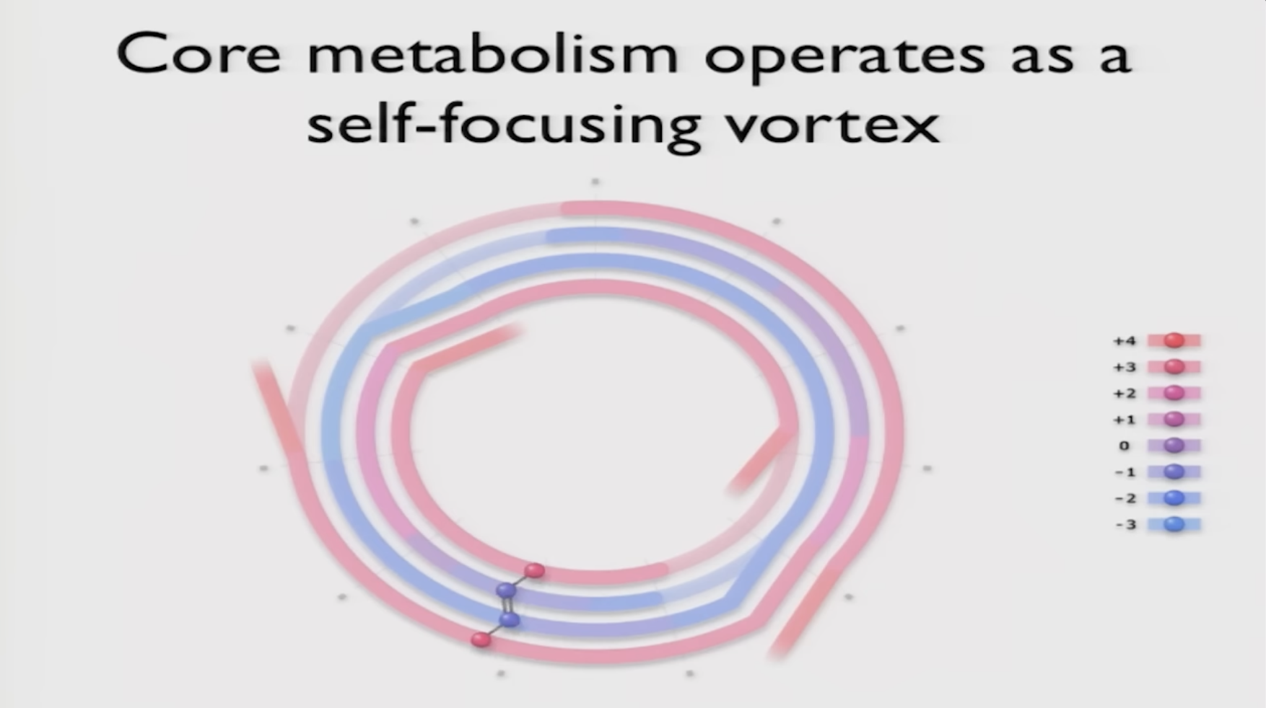
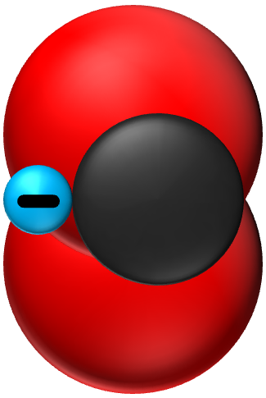
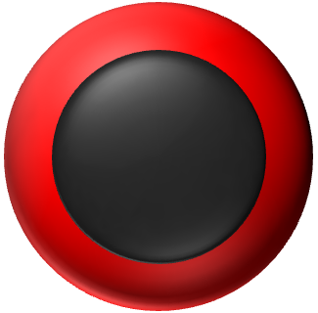
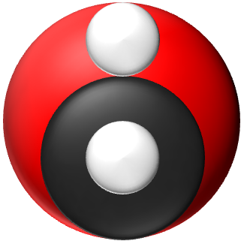
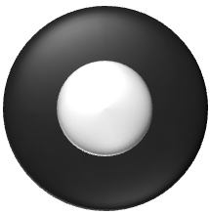
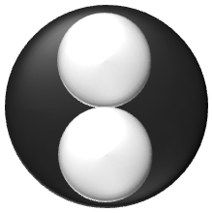

Slide 9
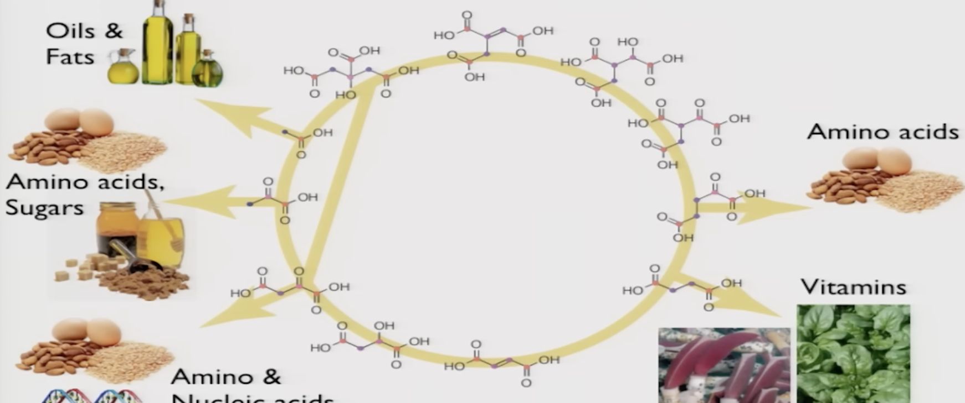
Glucose:
COH-HCOH-HOCH-HCOH-HCOH-CH2OH
Fructose:
CH2OH-(C=O)-HOCH-HCOH-HCOH-CH2OH
Pyruvic acid:
CH3-(C=O)-COOH
Oxalsäure (Kleesäure):
COOH-COOH
Citrate:
(COO-)-CH2-(OH-C-COO-)-CH2-COO-
Oxaloacetic acid (Oxalacetat):
COOH-CH-CH-COOH
Fumeric acid (Fumarsäure):
COOH-CH-CH-COOH
Succinic acid (Bernsteinsäure):
COOH-CH2-CH2-COOH

Slide 10
Fatty Acids
Oleic Acid:
(mono-unsaturated omega-9 fatty acid)
CH₃-(CH₂)₇-CH=CH--(CH₂)₇-COOH

Slide 11
Carboxylic Acids
Formic Acid:
(methanoic acid)
H-COOH
Butyric Acid:
(butanoic acid, butter)
CH₃-CH₂-CH₂-COOH
Acetic Acid:
(ethanoic acid, vinegar)
CH₃-COOH
Acrylic Acid:
(propenoic acid, simplest ansaturated)
CH₂=CH-COOH
Propionic Acid:
(propanoic acid, vinegar)
CH₃-CH₂-COOH

Slide 12
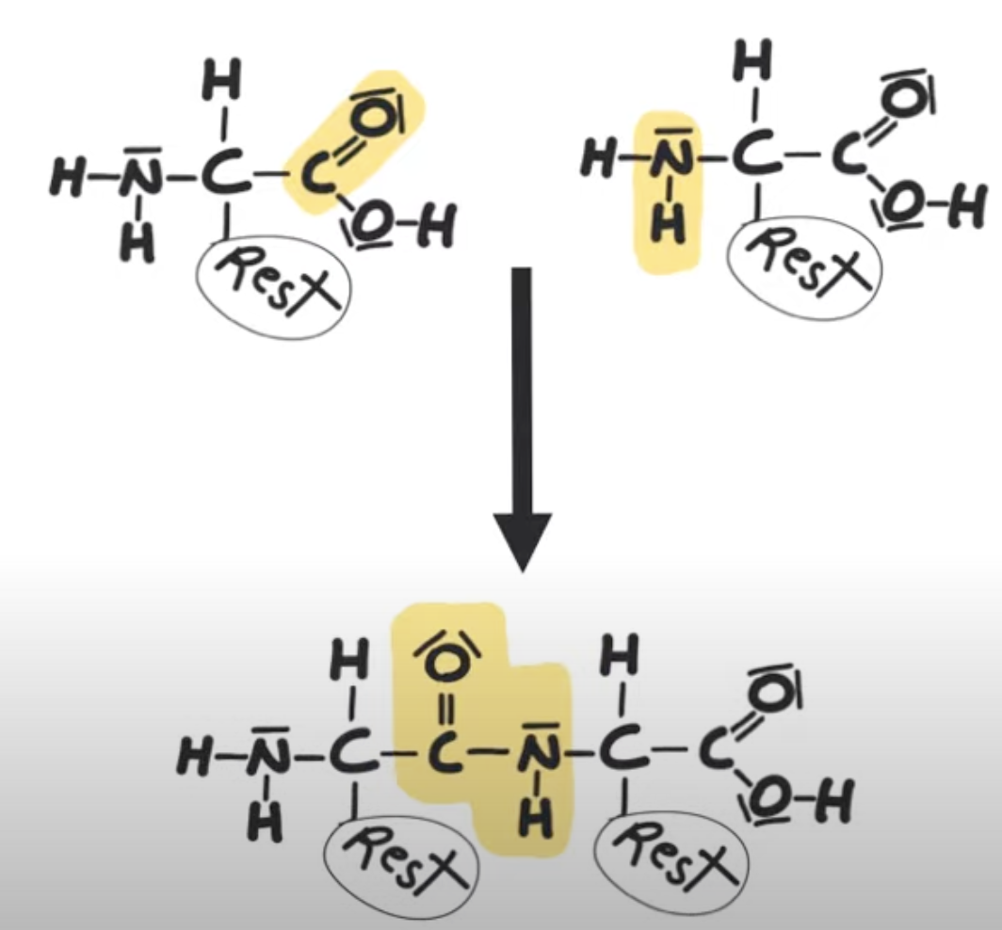
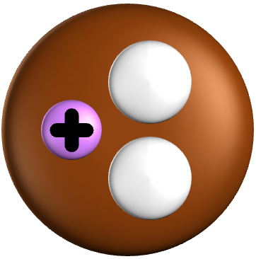
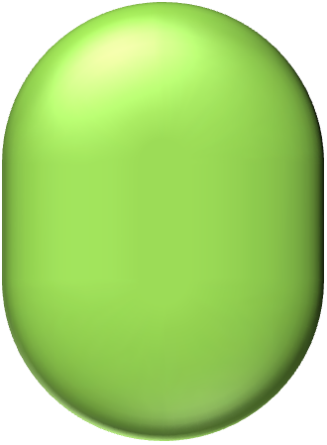
Amino Acids
Glycin:
(NH3⁺-CH-COO-)-H
Alanin:
(NH3⁺-CH-COO-)-H
Glutamin:
(NH3⁺-CH-COO-)-CH2-CH2-(C=O)-NH2
Serin:
(NH3⁺-CH-COO-)-CH2-OH

